Slide 1
Population
Data Collection
Sample
Inference

Slide 2
Unbiased
Biased
Low Variability
High Variability

Slide 3




Observational Study
Controlled Experiment
Gentle Bedside Manner
Kangaroo Care
Poor Bedside Manner
No Kangaroo Care

Slide 4
Confounder
(Temperature)
(Higher Temps → More Ice Cream)
(Higher Temps → Higher Risk)
Factor of Interest
(Ice Cream Sales)
Effect ?
Response of Interest
(Risk of Shark Attack)

Slide 5


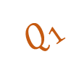




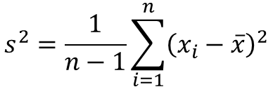

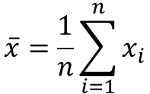

median
$$Q_{1}$$
$$Q_{3}$$
$$x_{i}=\text{i}\text{−}\text{th} \text{value}$$
$$\overline{x}=\frac{1}{n}\sum_{i=1}^{n}{x_{i}}$$
$$s^{2}=\frac{1}{n−1}\sum_{i=1}^{n}{{\left(x_{i}−\overline{x}\right)}^{2}}$$
$$Q_{1}=\text{25−}\text{th} \text{percentile}$$
median$=\text{50−}\text{th} \text{percentile}$
$$Q_{3}=\text{75−}\text{th} \text{percentile}$$
$$(x_{i}−\overline{x})$$
$$IQR=Q_{3}−Q_{1}$$
$$\overline{x}$$

Slide 6

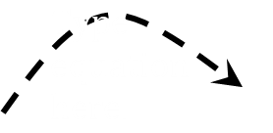





Population
$$\hat{θ}=\text{Estimate} \text{of} \text{Parameter}$$
$$\text{Sample}\text{ 1}→{\hat{θ}}_{1}$$
$$\text{Sample}\text{ 2}→{\hat{θ}}_{2}$$
$$\text{Parameter}=θ$$
Sampling Distribution
$$⋮$$
Random Sampling
$$\text{Sample} \text{m}→{\hat{θ}}_{m}$$

Slide 7






Population
Resampling
Bootstrap Resamples
$$\text{Resample}\text{ 1}→{\hat{θ}}_{1}^{∗}$$
$$\text{Original} \text{Statistic}=\hat{θ}$$
$$\text{Resample}\text{ 2}→{\hat{θ}}_{2}^{∗}$$
$$\text{Parameter}=θ$$
Bootstrap Model for Sampling Distribution
$$⋮$$
$$\text{Resample} \text{m}→{\hat{θ}}_{m}^{∗}$$

Slide 8





Null World
$$\text{Null} \text{Sample}\text{ 1}→{\hat{θ}}_{1}^{∗}$$
$$\text{Null} \text{Sample}\text{ 2}→{\hat{θ}}_{2}^{∗}$$
Null Distribution
$$⋮$$
$$θ=0.2$$
$$\text{Null} \text{Sample}\text{ 3}→{\hat{θ}}_{m}^{∗}$$

Slide 9
Group Mean
Within Group Variability
Between Group Variability
Response
Group I
Group II
Group III

Slide 10
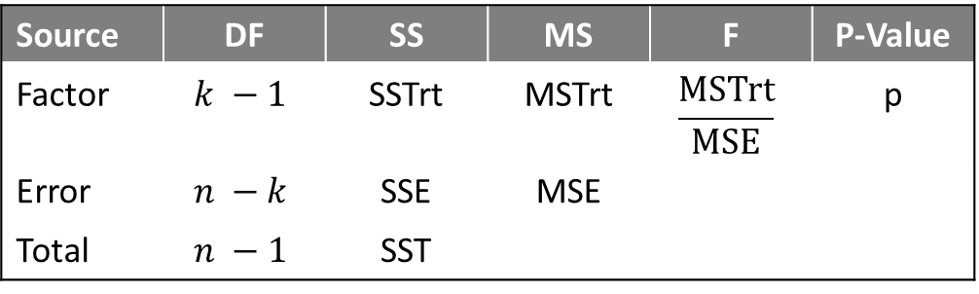
Partitioning Variability
Source | DF | SS | MS | F | P-Value
Factor | $$k −1$$ | SSTrt | MSTrt | $$\frac{\text{MSTrt}}{\text{MSE}}$$ | p
Error | $$n −k$$ | SSE | MSE
Total | $$n −1$$ | SST
Standardized Test Statistic
Estimate of Residual Variability

Slide 11
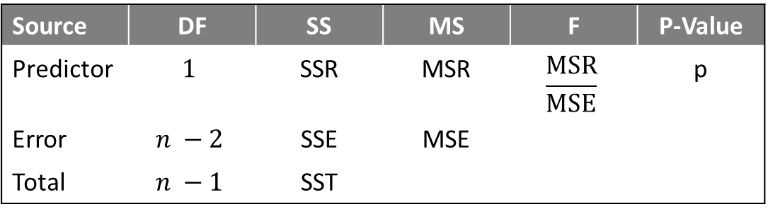
Partitioning Variability
Source | DF | SS | MS | F | P-Value
Predictor | $$1$$ | SSR | MSR | $$\frac{\text{MSR}}{\text{MSE}}$$ | p
Error | $$n −2$$ | SSE | MSE
Total | $$n −1$$ | SST
Standardized Statistic
Estimate of Residual Variability

Slide 12
Response
Predictor

Slide 13
$${\left(\text{Response}\right)}_{i}−\left(\text{Average} \text{Response}\right)→SST$$
Average Response
Response
$${\left(\text{Predicted} \text{Response}\right)}_{i}−\left(\text{Average} \text{Response}\right)→SSR$$
$${\left(\text{Response}\right)}_{i}−{\left(\text{Predicted} \text{Response}\right)}_{i}→SSE$$
Predictor

Slide 14
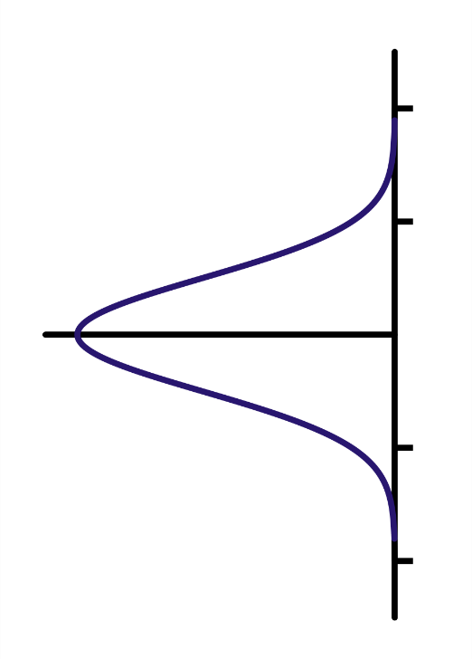

$$\text{Response}=β_{0}+β_{1}\text{Predictor}$$
All Independent
Variability in Errors
Response
Variability in Errors
Variability in Errors
Predictor

Slide 15
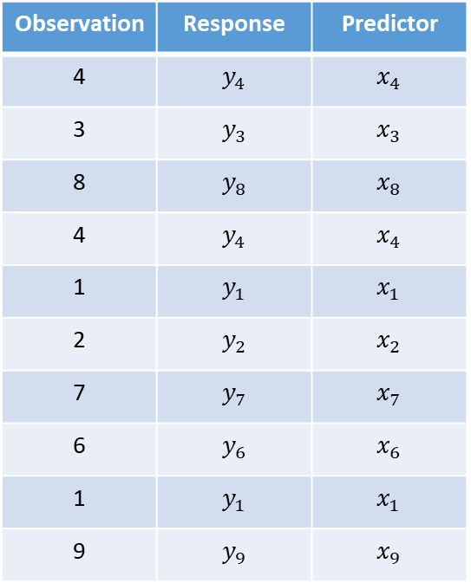
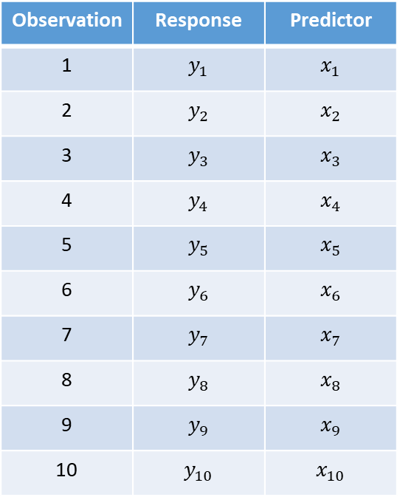
Original Sample
Example Bootstrap Resample
Observation | Response | Predictor
1 | $$y_{1}$$ | $$x_{1}$$
2 | $$y_{2}$$ | $$x_{2}$$
3 | $$y_{3}$$ | $$x_{3}$$
4 | $$y_{4}$$ | $$x_{4}$$
5 | $$y_{5}$$ | $$x_{5}$$
6 | $$y_{6}$$ | $$x_{6}$$
7 | $$y_{7}$$ | $$x_{7}$$
8 | $$y_{8}$$ | $$x_{8}$$
9 | $$y_{9}$$ | $$x_{9}$$
10 | $$y_{10}$$ | $$x_{10}$$
Observation | Response | Predictor
4 | $$y_{4}$$ | $$x_{4}$$
3 | $$y_{3}$$ | $$x_{3}$$
8 | $$y_{8}$$ | $$x_{8}$$
4 | $$y_{4}$$ | $$x_{4}$$
1 | $$y_{1}$$ | $$x_{1}$$
2 | $$y_{2}$$ | $$x_{2}$$
7 | $$y_{7}$$ | $$x_{7}$$
6 | $$y_{6}$$ | $$x_{6}$$
1 | $$y_{1}$$ | $$x_{1}$$
9 | $$y_{9}$$ | $$x_{9}$$
Randomly Resample

Slide 16

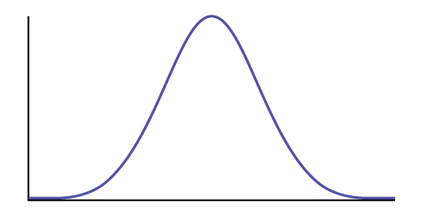

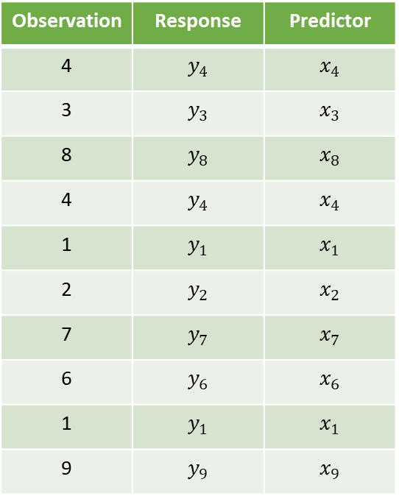



Data Generating Process
Data
Statistic
$$\hat{θ}$$
Model for
Sampling Distribution
Model for Response
Simulated Data
95% CI
$${\left(\text{Response}\right)}_{i}=f\left(θ,\text{Predictors}\right)+ε_{i}$$
$$\text{Values} \text{of} \hat{θ}$$
Classical Modeling Conditions on Error

Slide 17
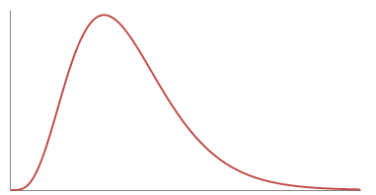


Data Generating Process
Data
Standardized Statistic
$$T^{∗}=\frac{MSR}{MSE}$$
Model for
Null Distribution
Model for Response in Null World
Simulated Data
p-value
$${\left(\text{Response}\right)}_{i}=f\left(θ_{0},\text{Predictors}\right)+ε_{i}$$
$$\text{Values} \text{of} T^{∗} \text{Under} H_{0}$$
Classical Modeling Conditions on Error

